Slide 1
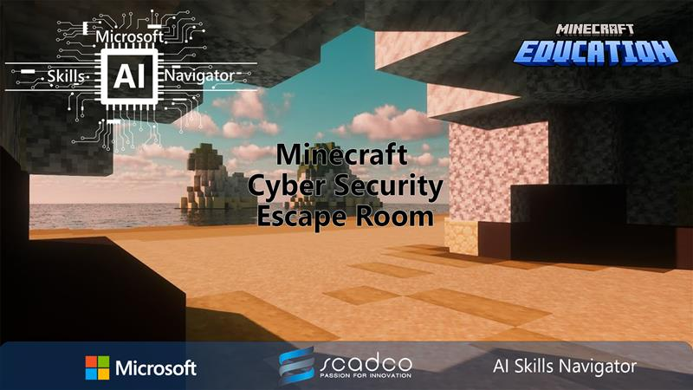
Cyber Security Minecraft Escape Room
Classroom Resource

Slide 2
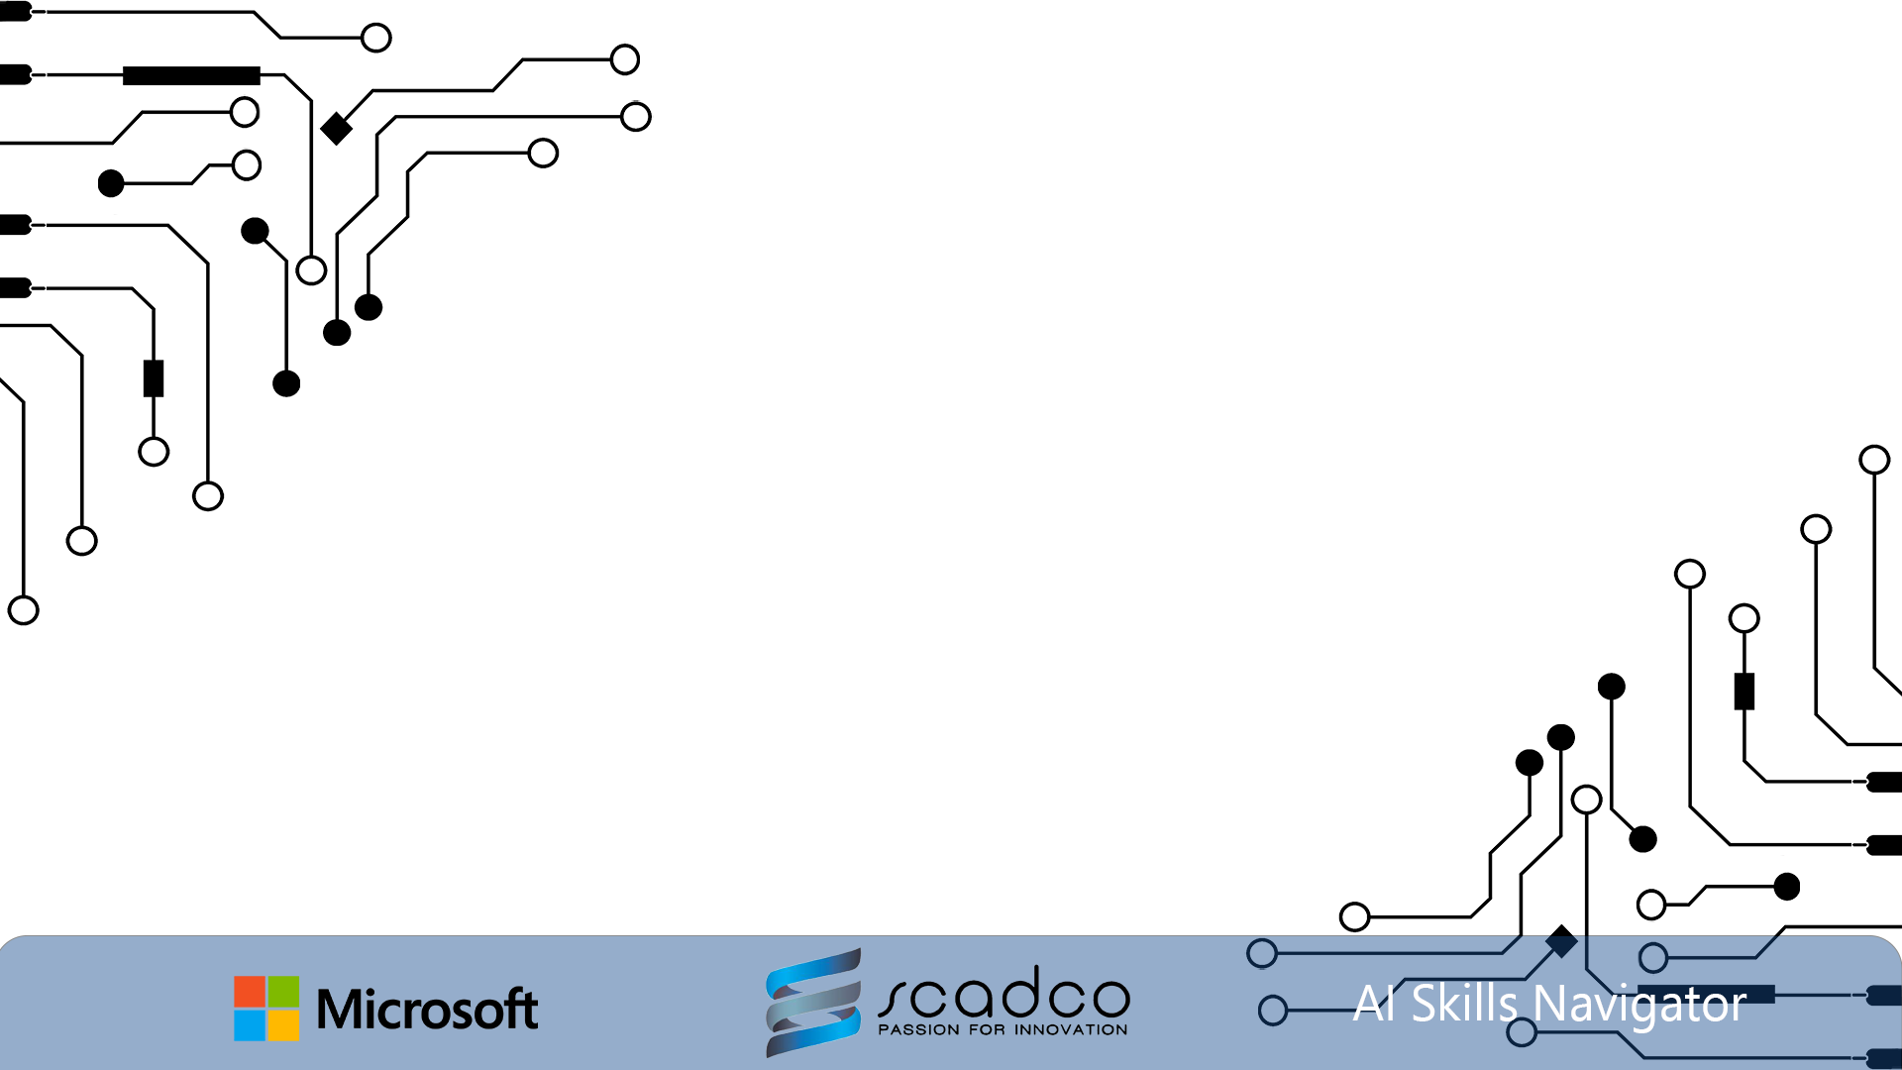


Vocabulary
Cyber Security
Firewall
Phishing
Malware
Hacker
Virus
Anti-Virus
Trojan
Spyware
Notes:
Cyber Security: Protects computers, networks, and data from unauthorized access, attacks, or damage.
Firewall: A security system that monitors and controls incoming and outgoing network traffic based on predetermined security rules.
Phishing: A fake attempt to obtain sensitive information by pretending to be a trustworthy entity in electronic communications.
Malware: Malicious software designed to harm, exploit, or otherwise compromise a computer system.
Hacker: A person who uses technical skills to gain unauthorized access to systems or data.
Virus: A type of malware that replicates itself and spreads to other computers, often causing harm.
Anti-Virus: Software designed to detect, prevent, and remove malware, including viruses.
Trojan: A type of malware that disguises itself as legitimate software but performs malicious actions once installed.
Spyware: Software that secretly monitors and collects information about a user's activities without their knowledge.

Slide 3

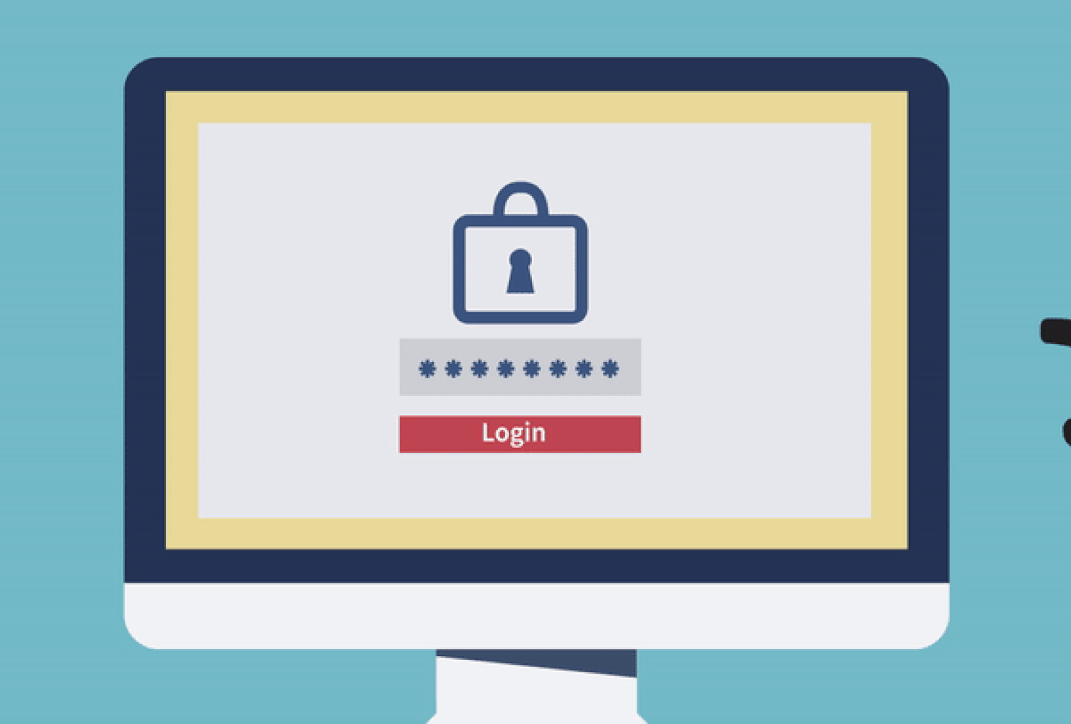
How to stay safe:
Strong passwords
Examples:
G7#kL9!vQ2@xT5
bR8$wN3^zP6&yM1
J4*eF7%uH2!sV9
Firewalls
Anti-virus software
Awareness
Notes:
Strong Passwords: Using complex and unique passwords makes it harder for attackers to guess or crack them, protecting your accounts and personal information from unauthorized access. Remember to use a mix of uppercase and lowercase letters, numbers, and special characters to create strong passwords.
Firewalls: Firewalls act as a barrier between your computer and the internet, monitoring and controlling incoming and outgoing network traffic based on security rules. They help block unauthorized access and potential threats.
Anti-Virus Software: Anti-virus software scans your computer for malware, including viruses, and removes any threats it finds. It also provides real-time protection by detecting and blocking malicious activities.
Awareness: Being aware of common cyber threats, such as phishing scams and suspicious links, helps you recognize and avoid potential dangers. Educating yourself about safe online practices reduces the risk of falling victim to cyber attacks.

Slide 4
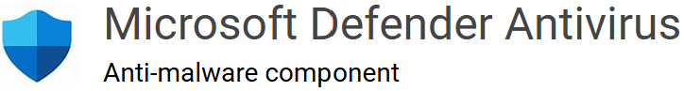
Microsoft Defender
Notes:
Microsoft Defender is a built-in security tool in Windows that helps protect your computer from viruses, malware, and other threats. It provides real-time protection by scanning files and programs as you use them, and it also offers features like firewall protection, network security, and parental controls. Essentially, it's designed to keep your computer safe and secure without needing additional software

