Slide 1


Slide 2
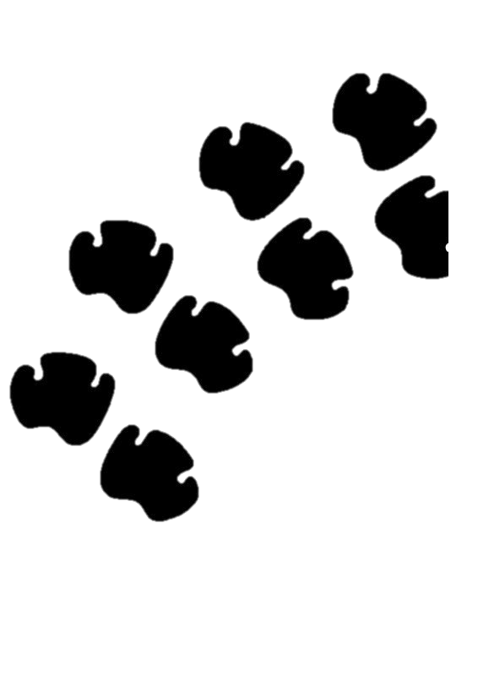
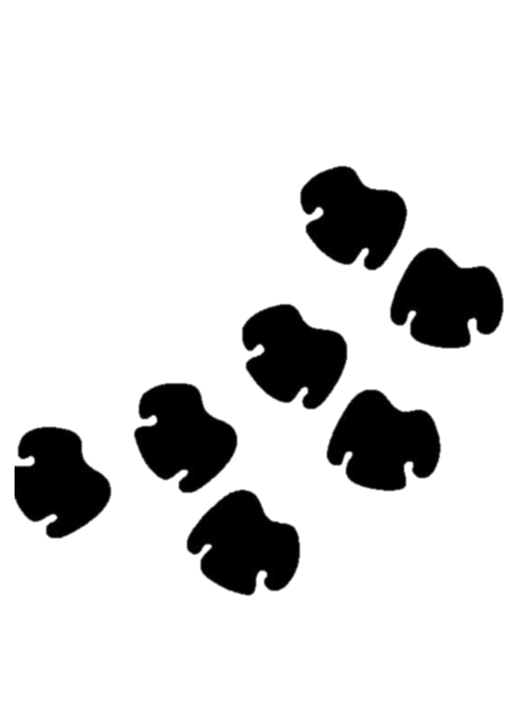
Vocabulary
Command block
Poacher
Anti-poaching efforts
Surveillance
Authority
Coding/Programming
Rhino

Slide 3
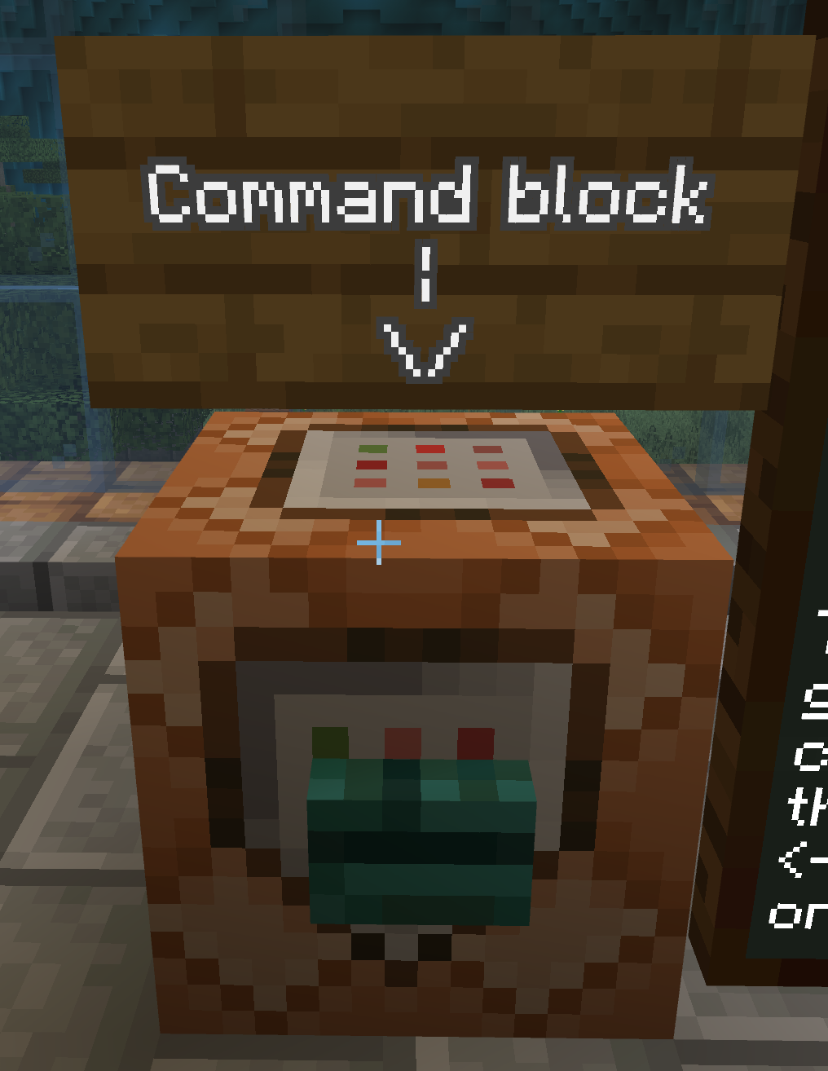
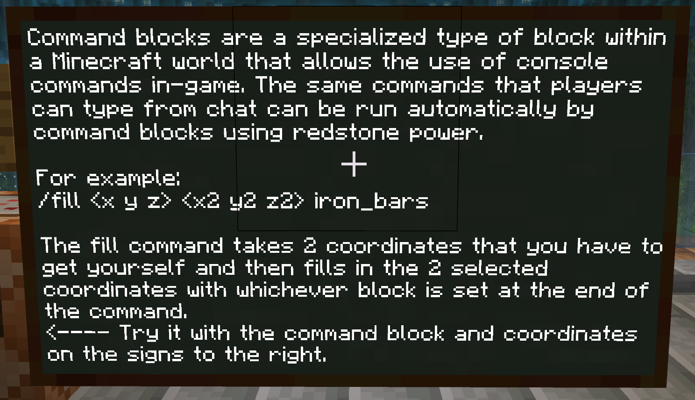
How to use a command block
Command blocks in Minecraft are special blocks that can execute commands automatically when powered by Redstone.
Learners must:
Left click the command block
Insert the co-ordinates
Click the button
It is advised that the learners write down the co-ordinates as it may be challenging to copy and paste the coordinates into the command block.
Notes:
Command blocks in Minecraft are special blocks that can execute commands automatically when powered by Redstone. They are primarily used in Creative mode, multiplayer servers, and custom maps to automate tasks and create complex gameplay mechanics.
Learners must:
Left click the command block
Insert the co-ordinates
Click the button
It is advised that the learners write down the co-ordinates as it may be challenging to copy and paste the coordinates into the command block.
Left-click : It is important that the learners LEFT CLICK as right clicks might destroy the blocks and the world will have to be reloaded.
Co-ordinates: Co-ordinates are needed and can be written into the command block in the following order: x y z x2 y2 z2. It is suggested that the learners write down the co-ordinates instead of copying and pasting them.

